Slide 1
Choosing a model, fitting your data, and calibrating your epidemic
2019 HIV Estimates Workshop

Slide 2
Part 4: Fitting incidence and prevalence
Demographic Data
Demographic and Epidemic Calculations
Mother-to-child transmission
Child model
Adult model
Results
Number HIV+
New Infections
AIDS deaths
Need for PMTCT
Orphans
Program Statistics
Epidemic Patterns
Surveillance and Survey Data
Prevalence / incidence trend

Slide 3
What’s new for curve fitting and calibration in concentrated epidemics
ANC-RT testing data is now included in the fitting
Variance inflation is included to better represent uncertainty in results

Slide 4
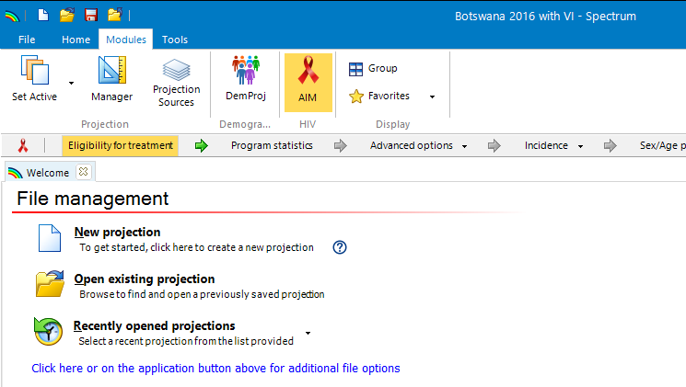
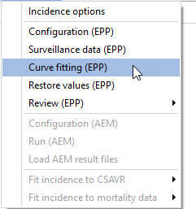
Incidence menu – Curve fitting (EPP)

Slide 5
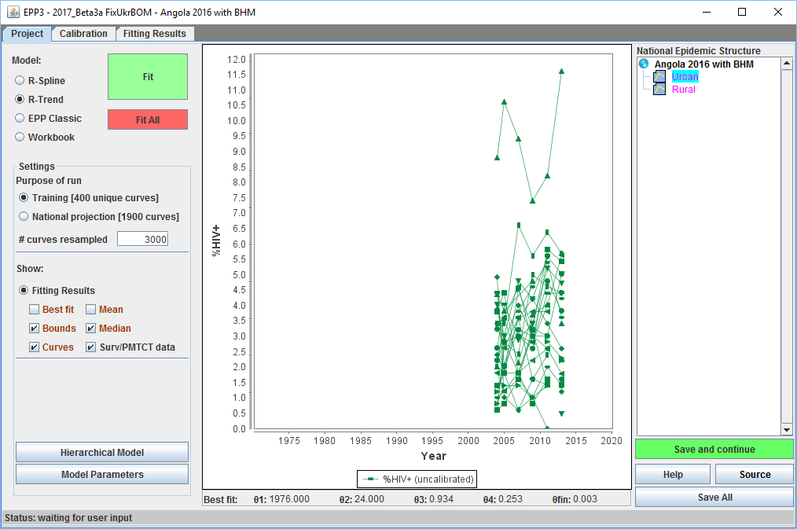
Brings up the Project Page
Model selection and fitting
Settings
Results to display on the graph

Slide 6
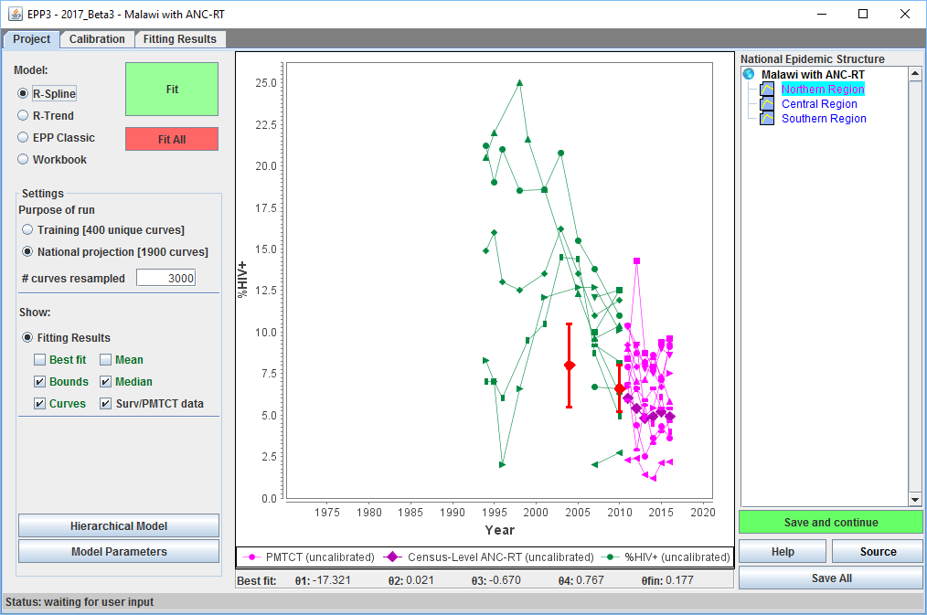
If using ANC-RT, data displayed on graphs
ANC-RT data displayed
in purple
ANC-RT census in
dark purple

Slide 7
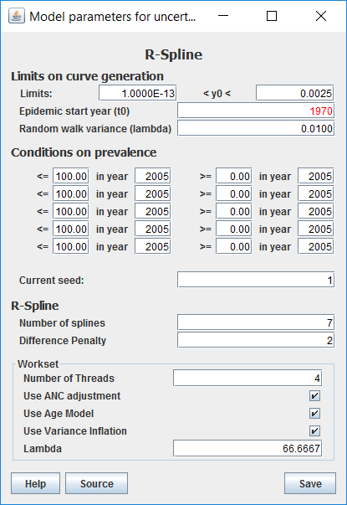
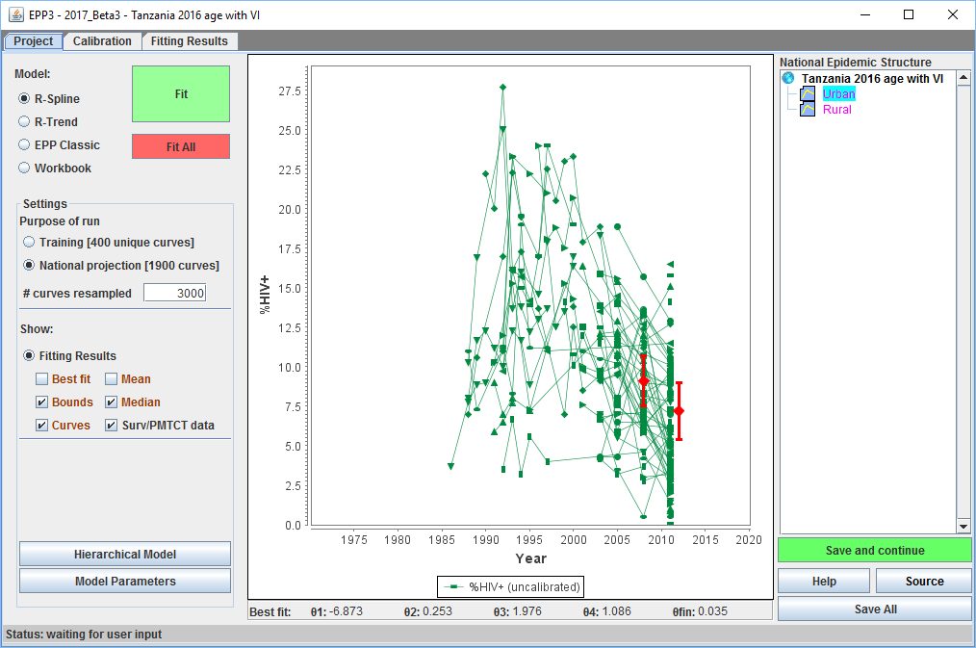
Variance inflation will normally be used
By default variance inflation will be turned on
May affect early shape of curve, after fitting use the “Compare” option on Fitting Results page to view the changes
Will generally increase uncertainty
To turn it off, uncheck the box

Slide 8
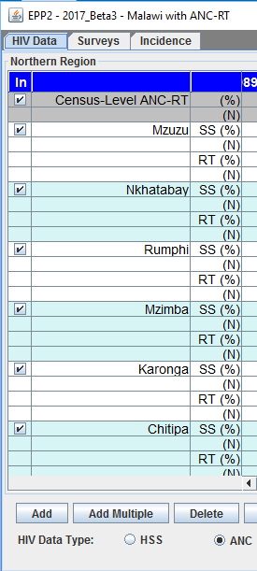
Check settings if using ANC-RT data in fitting
Before starting go back to:
AIM Incidence->Surveillance data (EPP)
and review settings for ANC-RT data
If you want to use ANC-RT data make sure you are in “ANC” mode
Select “ANC” under “HIV Data Type”
Decide if you want to include census ANC-RT data
If so, make sure to check the box in the first column of the census data rows
Variance inflation will be turned on if you fit with census data
If you do not want to use the census data, uncheck the box

Slide 9
Now you’re ready to fit

Slide 10
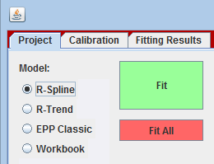
Model selection and fitting
Spectrum 2017 offers four fitting methods
R-Spline
R-Trend
EPP Classic
Workbook (no longer used)
One-click fitting or fit all sub-populations

Slide 11
Model characteristics
R-Spline (default)
Applies a set of smooth mathematical functions to give smoother incidence curves
R-Trend
Draws on past experience with trends in r observed in actual epidemics to produce a smooth curve
EPP Classic
A four parameter model that is useful in low data situations and produces an epidemic that rises and plateaus
It is possible to mix and match models
for different sub-populations

Slide 12
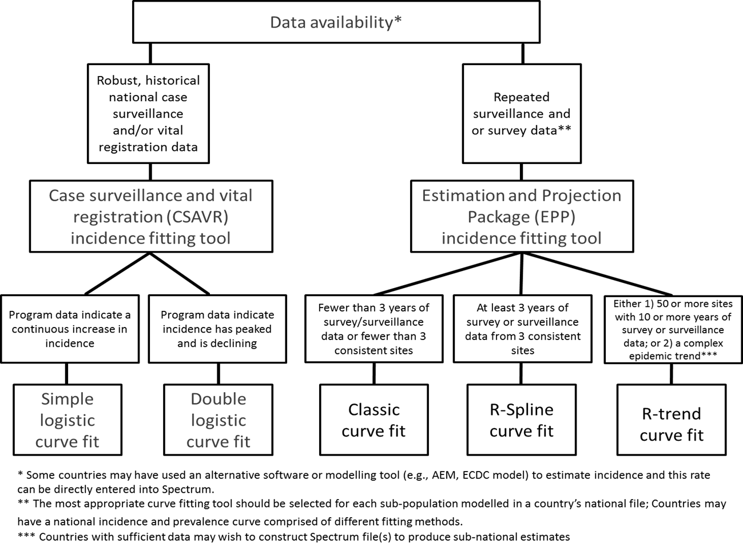

Slide 13
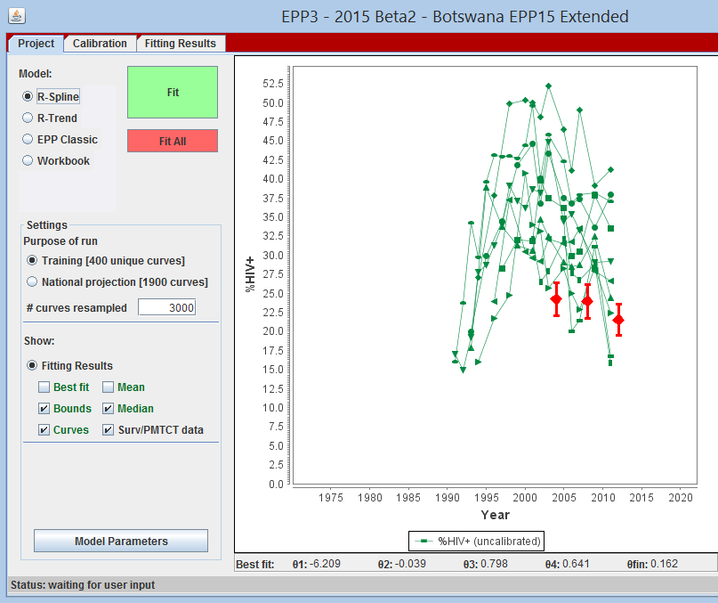
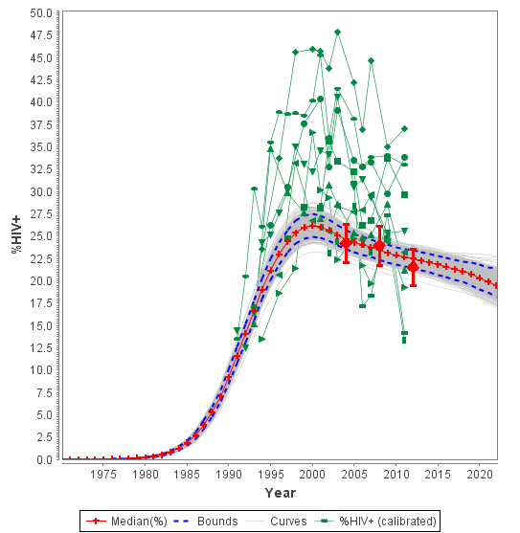
One-click fitting Choose model type, click “Fit” button – EPP does the rest

Slide 14
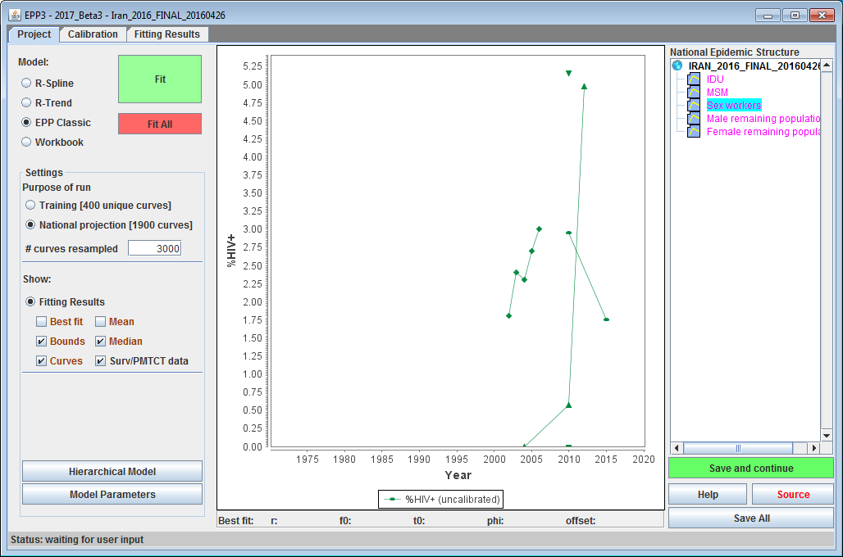
Fit All - Really one-click fitting
Click a sub-pop in the tree
2. Pick the model type
3. Repeat selection of model type for each sub-population
4. Click “Fit All”
5. Go have a
coffee
6. When done, click on each sub-population and then press “Save and continue” or results not saved OR Click “Save All” to save everything

Slide 15
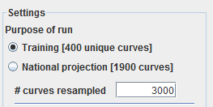
Settings
Two options:
Training
National Projection
Number of curves generated differs
400 for training – okay to test curve fits
1900 for national projection – must be selected in final file
Number of curves to resample
Always leave at 3000

Slide 16
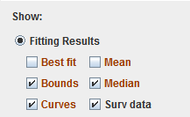
What to show in graph
Select all options to show in graph
Best fit – the curve that mathematically fits the data best
Bounds – 95% of your curves fall between the blue lines
Curves – show the actual unique curves
Mean – year-by-year means of all resampled curves
Median – year-by-year medians
Surv data – your surveillance data
Surveys appear as red diamonds with 95% CIs shown (%HIV +/- 2 * SE)

Slide 17
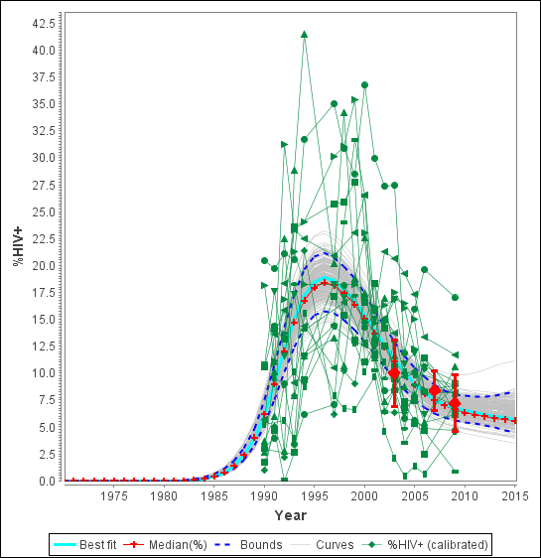
A clearer picture of what’s in the graph
Graph with:
Surveillance data
Unique curves (light gray)
95% CI Bounds (dashed lines)
Bayesian median (red with +)
Mean (blue with )
Best fit (cyan/light blue)
Surveys (red diamonds with
95% CI (+/- 2 * SE)

Slide 18
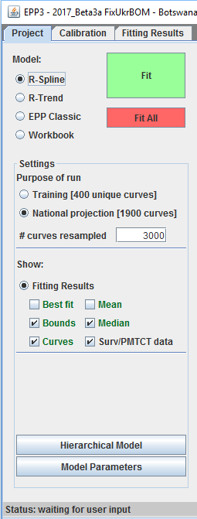
Adjusting the models – Model parameters
Model parameters
Allows for a change in model parameter values from which initial samples are constructed
Different for R-Spline, R-trend and EPP Classic (next slides)
Generally only for advanced users who understand the models well, except for a few options

Slide 19
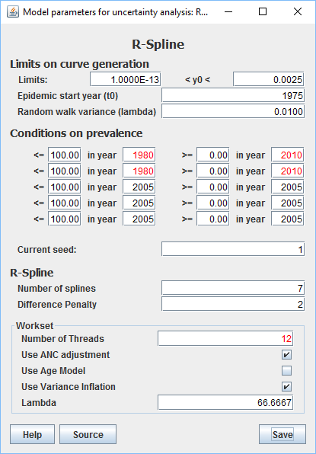
Model parameters – R-Spline
Things you might want to change:
Epidemic start year (t0) to about 5 years before the first data point
Normally set for your country from a database

Slide 20
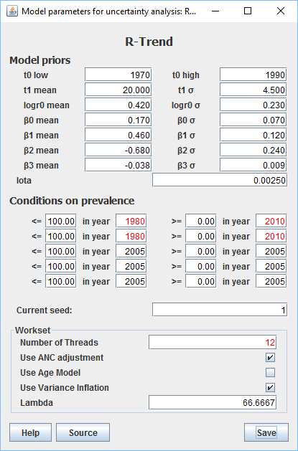
Model parameters – R-Trend
Things you might want to change:
t0 low: earliest start year possible
t0 high: latest start year possible
Especially useful to adjust for later starting concentrated epidemics (e.g. Eastern Europe)

Slide 21
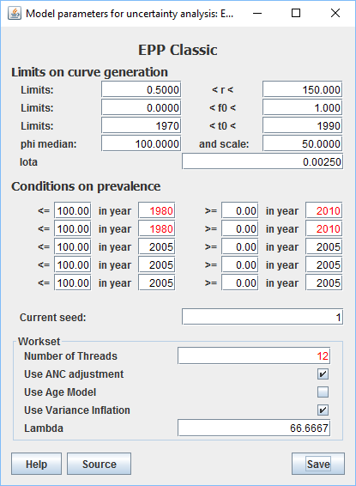
Model parameters – EPP Classic
Things you might want to change:
year1 < t0 < year2
High and low limits on the epidemic start year
Especially true for later starting concentrated epidemics (e.g. Eastern Europe)

Slide 22
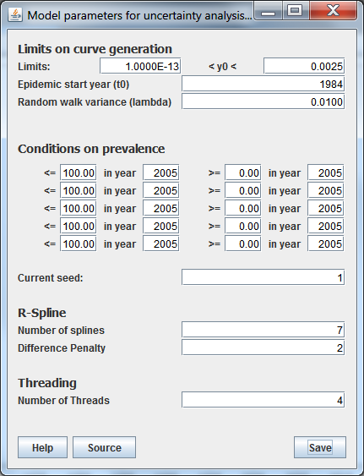
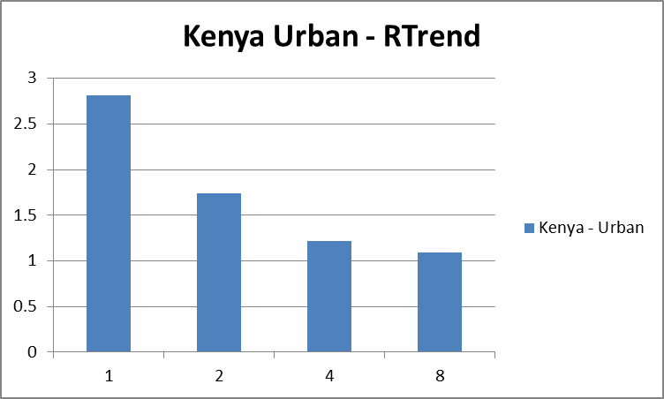
EPP can use more than one processor
Most new computer have 2 to 4 processors built-in
To speed fitting, EPP can use them
Time to run (minutes)
Number threads (4 processor machine)
Controls number used – set to
2 * number of processors (i.e., 4 for most laptops)

Slide 23
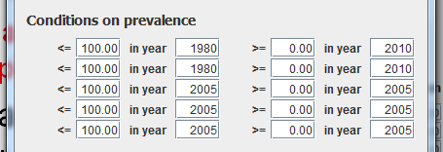
Prevalence conditions
Common to all models
One feature we do expect users to use if there are unrealistic curve sets
Necessary, especially in sparse data concentrated epidemics with unrealistic early rising epidemics

Slide 24
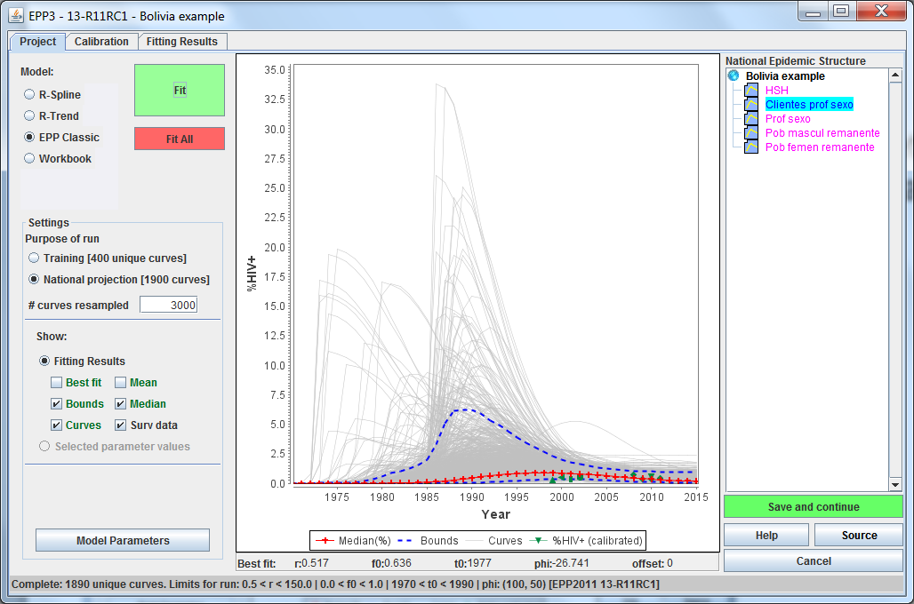
Using prevalence conditions
Prevalence conditions eliminate unrealistic curve sets - seen with sparse data or when all data is in later years
Clearly unrealistic sets of curves in 1970s to
late 1980s

Slide 25
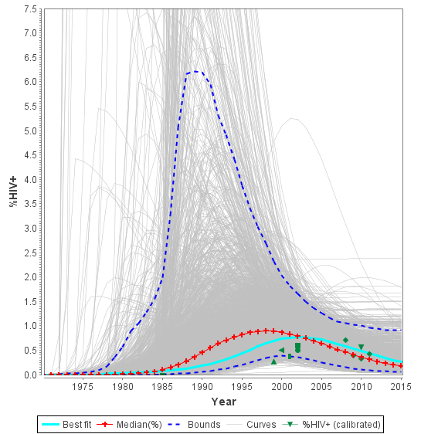
If we take a close up by rescaling graph
Can see that these unrealistic curves are driving up the median curve. This is problematic when using the median as “the” fit.

Slide 26
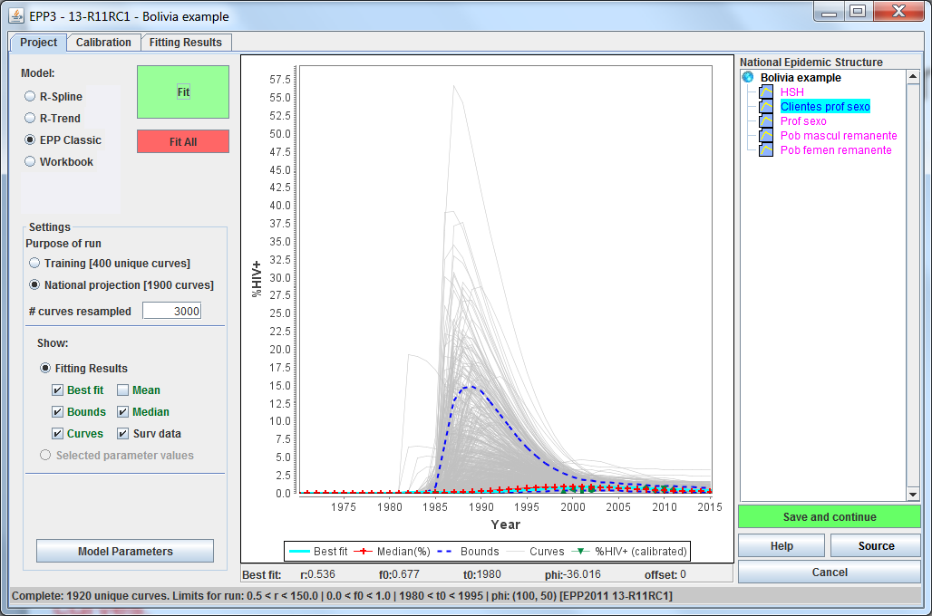
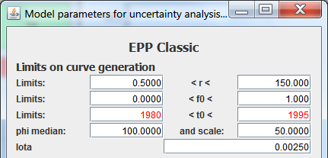
First thing, try later start years
Under Advanced Options for EPP Classic, set start year range to 1980 to 1995
That got rid of the early stragglers, but still mid to late 1980 problem curves.

Slide 27
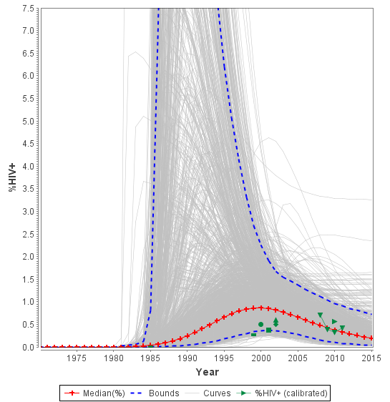
Looking more closely
Looking at this we see a cluster coming up too quickly in 1985
Main cluster, which looks reasonable epidemiologically is down here

Slide 28


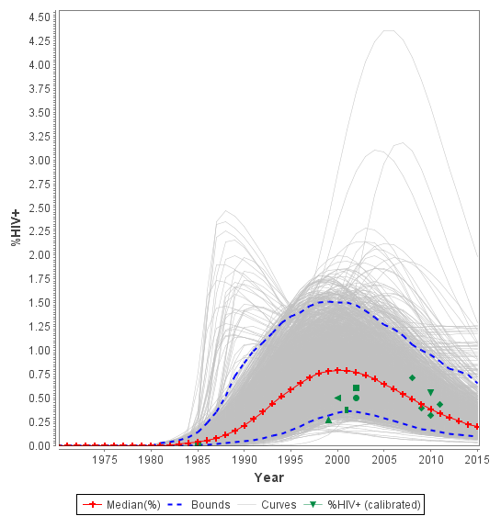
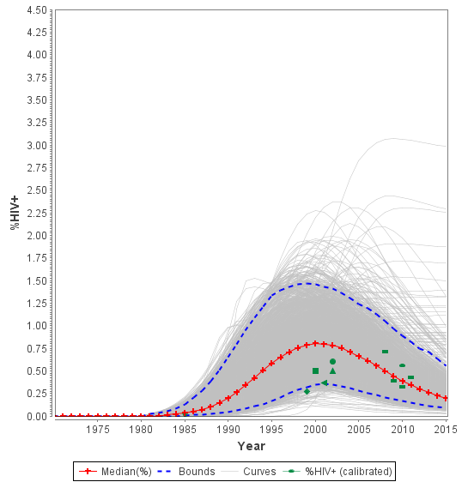
Now try applying prevalence conditions
And one more time to get rid of this group

Slide 29
Recommendations for prevalence conditions
If R-Trend or EPP Classic is used, make sure the start year covers full range of possible start years (e.g, 5 years before first data point to 5 years after that point)
Before applying any prevalence conditions run the model without any constraints then examine results for unrealistic curves
Limit the number of prevalence conditions to the minimum number needed to eliminate unrealistic curves. Too many conditions constrains legitimate fits

Slide 30
Recommendations for prevalence conditions
Do not set lower constraints and higher constraints in the same year - constrains uncertainty and may prevent good fits
Avoid setting constraints close to years in which data are available (within 3-5 years) if possible
If you do set them in data years set them very wide (e.g., at 80-90% prevalence or 5-10 times maximum observed HIV
Look at the resulting fit relative to the data in deciding if the fit is reasonable

Slide 31
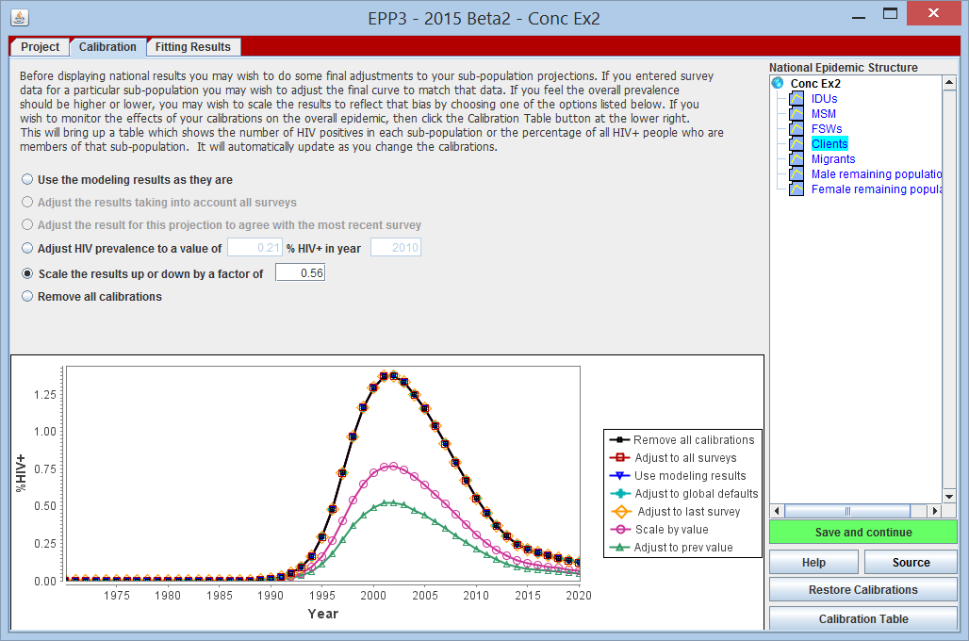
Next, we need to calibrate our curves
The Calibration Page – make final adjustments before generating national results
Results of each calibration shown in the graph
In Concentrated Epidemics, if you want to calibrate your data, this is the place to do it (after the fitting)
31

Slide 32
The Calibration Page has 6 options:
Use modeling results as they are
Adjust results taking into account all surveys
Adjusts best fit curve to average of surveys
Adjust to result of last survey
Adjusts best fit curve to go exactly through last survey value
Adjust the prevalence to a value of ___ in year ____
Let’s the user set the level and year
Scale the results up or down by a factor of _____
Multiplies all values by the amount specified
Remove all calibrations
Returns you to the raw model, undoing any fitting adjustments
32

Slide 33
Restore Calibrations
When EPP starts it records the current calibrations
If you refit, the calibration is reset to “Use the modeling results as they are”
This button restores the calibrations that existed at startup

Slide 34
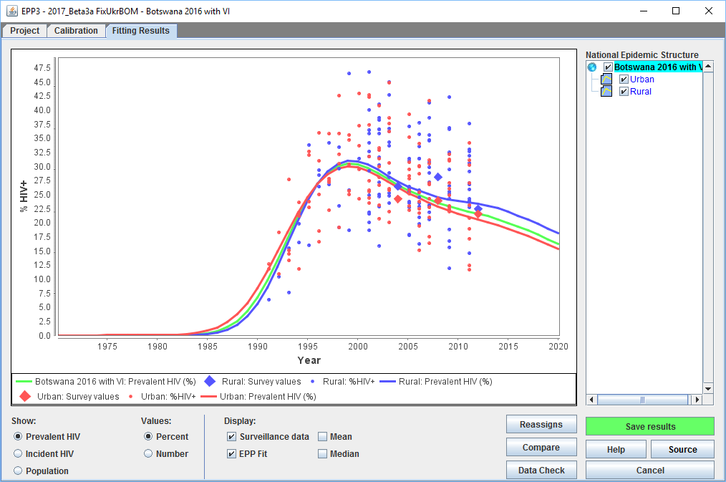
After calibrating, review your results
The EPP Fitting Results Page. Lets you look at:
Prevalence (# & %)
Incidence (# & %)
Population
34

Slide 35
Why is the Results Page here?
To let you visualize your national results and see what is contributing to your overall epidemic
Look for outliers or strange curves
See if one group seems to be contributing too much to be reasonable
To understand what is creating a complex national trend
To let you generate your national incidence estimate and pass them to Spectrum
When you hit “Save results”, Spectrum reads in the incidence automatically
Spectrum then calculates a number of other HIV-related outcomes and program indicators
Take the time to go through it carefully.
You MUST click “Save results”
35

Slide 36
Comparison and data checks

Slide 37
The issue: national projections change as new data is entered & our models change
One-button fitting leads to one-button fits
Users do not use prevalence conditions to remove epidemiologically unrealistic curves
Fits are unstable in low data situations
One or two additional points can totally change the conclusions
So you need to do two things
Compare your previous national projection with your new one and understand the differences between them
Check your national projection against other sources of information to see if it makes sense

Slide 38
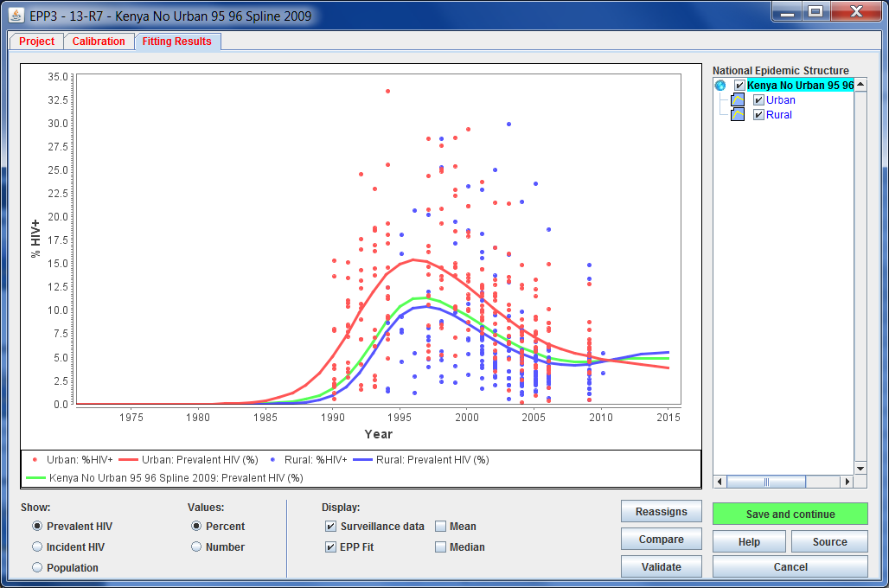

Compare button on Fitting Results Page
Adds a comparison with previous SPT or PJNZ file
Makes it easier to correct problems or catch & understand differences before policymakers ask questions

Slide 39
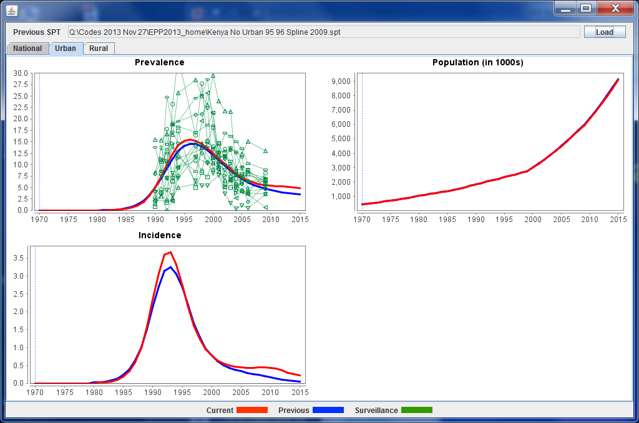
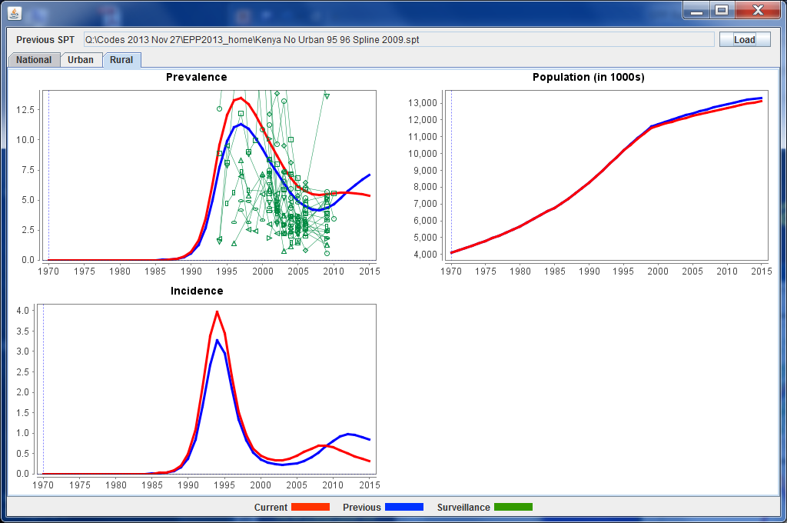
Individual sub-pop comparisons

Slide 40
Be sure to use Compare to explore your new projection relative to the previous one

Slide 41
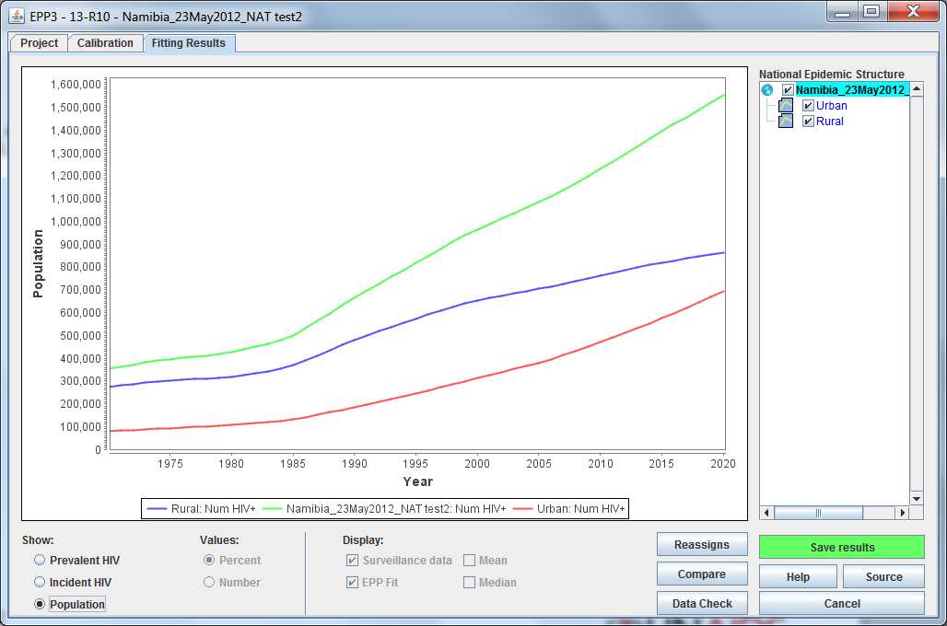
Final critical step: click “Save results”
Saves your results so Spectrum can use them. Otherwise Spectrum will use your old results.

Slide 42
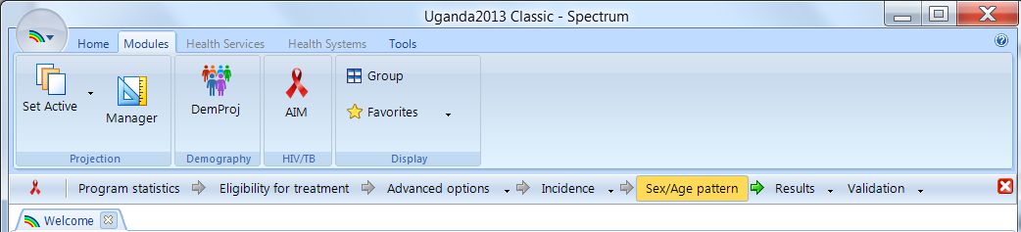
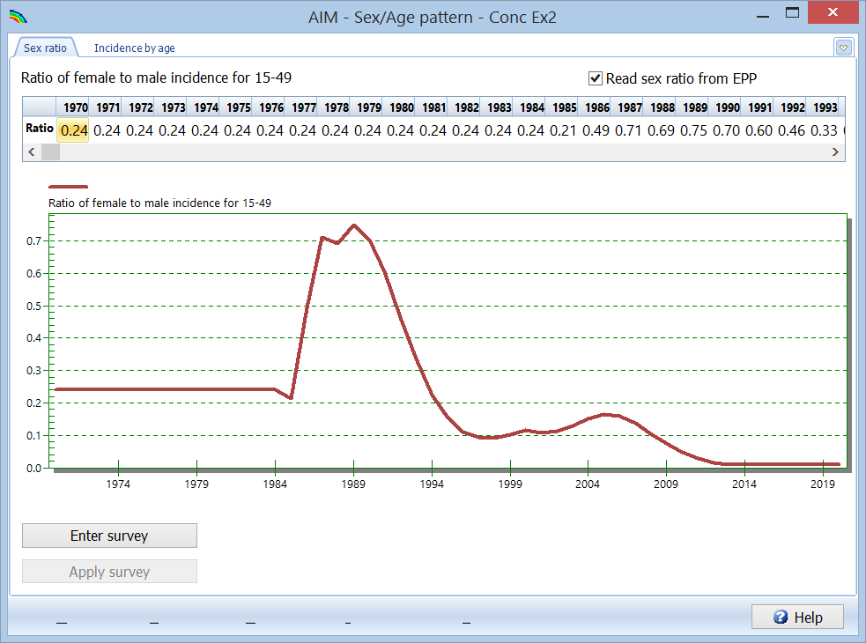
Back in Spectrum, click “Sex/Age pattern”

Slide 43
Steps
Review model parameters
Decide on model choice (R Spline, R Trend, EPP classic)
Fit model
Review results and add curve restriction if necessary
Decide on calibration
Compare to last year’s curve
Save results

